Slide 1
Functions

Slide 2
Functions
When programming we will often need to perform a specific task several times, at different points in the program, this is when functions come in handy.
A function is a portion of code within a larger program that usually does something very specific.
Functions in flowcharts are represented using this symbol:

Slide 3
Example 1: Flowchart
Design and code a program that asks the user to input two numbers and uses a function to compare the numbers and output the largest number.
Start
INPUT Num1
INPUT num2
COMPARE
End

Slide 4
Example 2: Flowchart
Design and code a program that asks the user to input two numbers and uses a function to compare the numbers and output the largest number.
Sub COMPARE
Is num1 > num2?
Yes
OUTPUT num1
No
Is num1 < num2?
Yes
OUTPUT num2
No
OUTPUT “They are equal”
End CHECKNUM

Slide 5
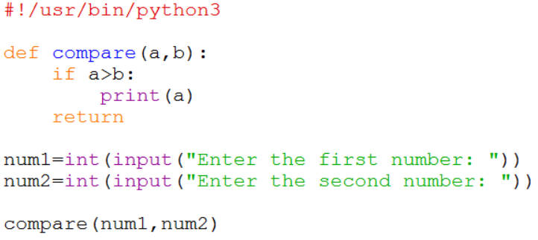
Example 1
Here is part of the solution to the problem, you need to complete it.
Comment your code, explaining what each bit does.

Slide 6
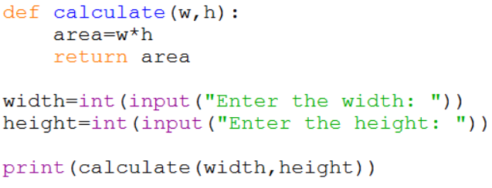
Returning a Value
You can also return a value from a function.
In this example the width and height of a rectangle are passed to a function, the area is then calculated and returned.
Returns the value in area variable
Prints the returned value to the screen.

